Slide 1
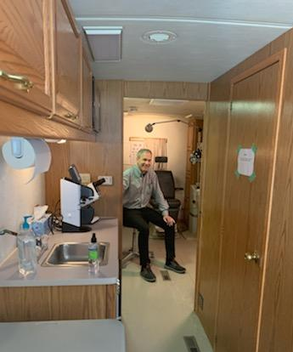
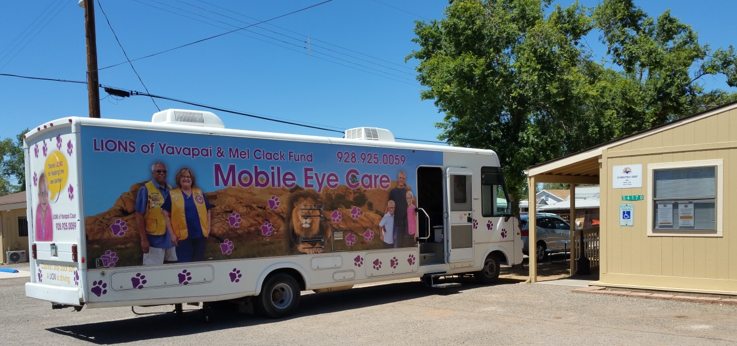
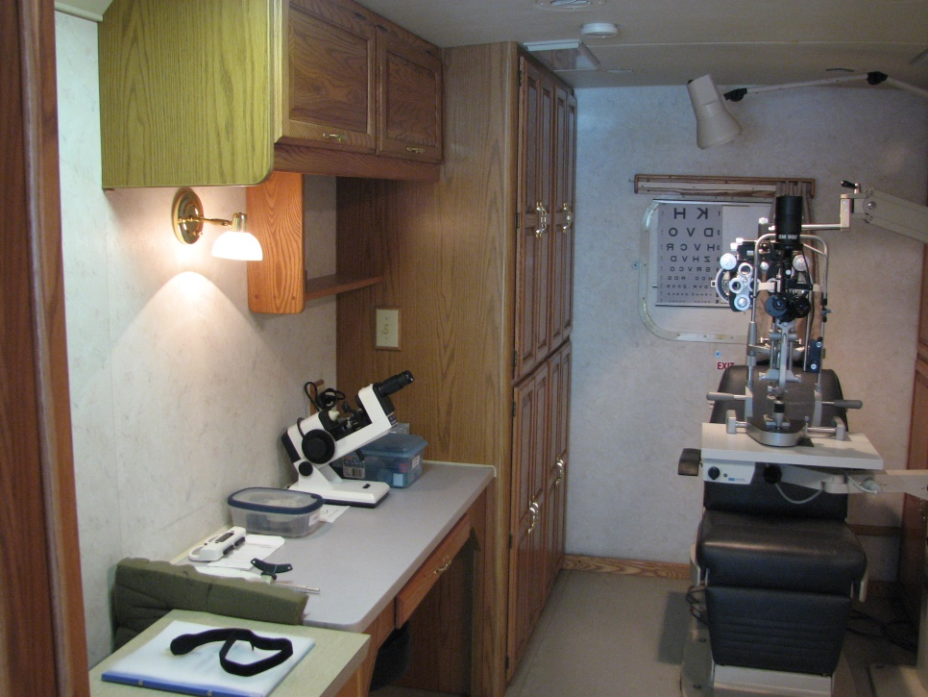
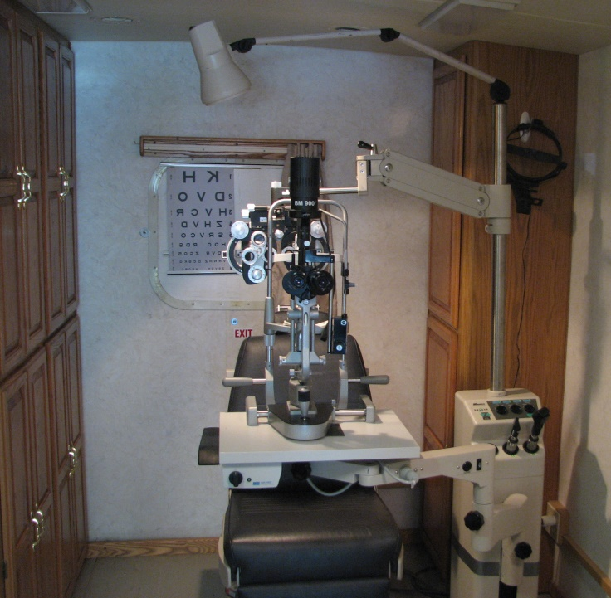
Lions of Yavapai Mobile Eye Care Van

Slide 2
Program Background
A study Lion Joe Preston initiated to try to better serve the sight impaired in Yavapai County included traveling to rural county towns and speaking to local people about eye care where they live, studying county demographics.
A study was done in 2014 to credibly measure the extent of eye care service need in every rural town in the county and local residents were asked about how eye care worked there. Towns visited included: Ash Fork, Bagdad, Black Canyon City, Camp Verde, Cordes Lakes, Mayer, Paulden and Seligman.
Each community had issues in common with other communities and other issues that were unique to that community. But one theme was a constant:
Wherever there was a Lions club, there was support for eye care. However, most of these rural areas had no Lions clubs and indeed little access to, or scant funds for, eye care. People in rural areas many times went without proper eye care. And transportation to towns with eye care was not always available. It became clear that bringing eye care to these rural towns would be the best way to deliver eye care.
At the time the use of an AZ Lions Mobile Eye Lab was an available for a fee. Using this resource required a number of steps including scheduling the lab, enlisting volunteer doctors, notifying local residents with restricted incomes and setting appointments and running an eye clinic.

Slide 3
However, an other option became available. Through private and Lions club funding, we were able to procure a used mobile eye exam office set-up in an RV from the New Mexico Lions in 2015. This is now the Lions of Yavapai Mobile Eye Care Van.
The Mobile Eye Care Van is a fully equipped mobile eye doctor examination room. It can be used by volunteer eye doctors to give eye exams and write prescriptions for eye glasses. It was our mission to use this mobile doctor’s office to bring eye care services to rural parts of Yavapai County, with particular attention to those residents who lack the means for or access to eye care services. There is no charge to the recipients of these services.
At the same time Lions of Yavapai was formed and began the process of accreditation with the IRS and LCI. The startup involved pilot events at the end of 2015 and in 2016, while we worked on an organizational structure and developed the funding parameters for utilizing the Mel Clack Fund. This also included trying to recruit eye doctors, which was one of our biggest challenges. We then began to run eye care events the second half of 2017.

Slide 4
Lions of Yavapai Eye Care Van Event
A typical eye care event entails giving eye exams for approximately 20 clients. In addition to their exam, the clients are given a choice of designer frames to choose from and will have a pair of glasses mailed to them as a result of this event.
The list of sites in Yavapai County where eye care events exams have been held are:
Ash Fork, Bagdad, Black Canyon City, Camp Verde, Cordes Lakes, Mayer, Paulden, Seligman, Yarnell, and Wilhoit. Many of these have had two, and some three, events.
Approximately 7 Lions and a volunteer doctor staff each event along with the local site organizer. We also try to invite Lions from other Lions clubs in Yavapai County. These events are managed by PNL Lions Paul Chastain and Doug George
Table 7‑4: Eye Care Van Clients That We Assisted Through 2021
*Note: One or more events cancelled due to the coronavirus pandemic

Slide 5
2022 Remaining Eye Care Van Events
Date | Location | Time | Contact
August | Yarnell | 9:00 - 4:00 | Rosalie Lechner
 | Presbyterian Church |  | 928-427-3421
Saturdays
August 20 | CONFIRMED
September | Mayer Area Community Service Center | 9:00 - 4:00 | Anne Marie McCoy
 |  |  | 928-632-7511
Weekdays
Sept. 16 | CONFIRMED
October | Camp Verde | 9:00 - 4:00 | Carson Ralston
Date open | Community Library |  | 928-554-8391
Weekdays
TBD | PLANNING STAGE
November | Prescott
Date open | In-town sign-up event
TBD | PLANNING STAGE
December | Black Canyon City | 9:00 - 4:00 | Shawn Snelling
 | Squaw Peak Realty |  | 623-374-9363
Saturdays
December 3 | CONFIRMED
7-31-22

Slide 6
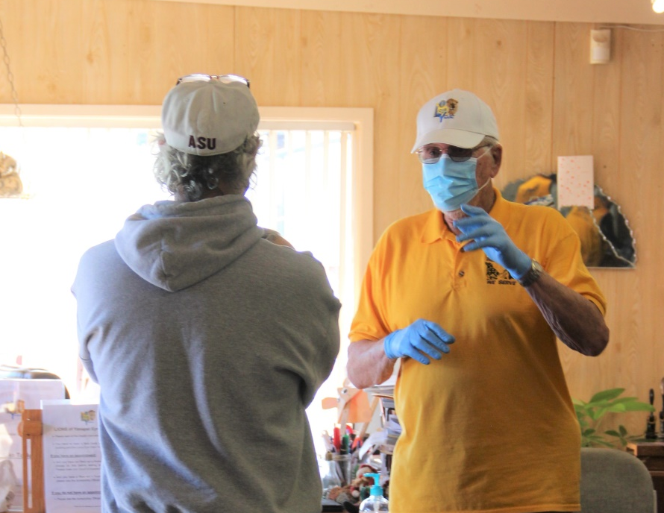
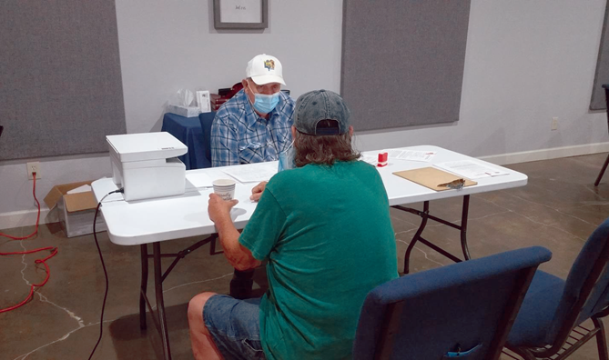
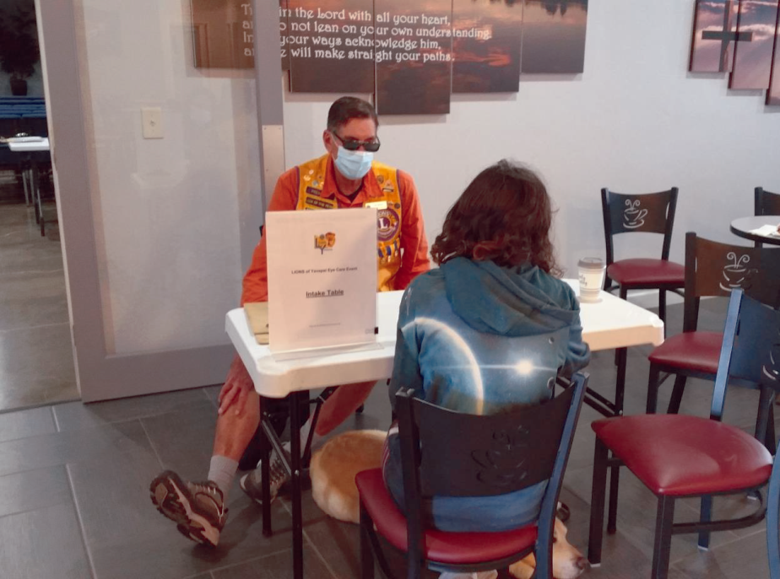
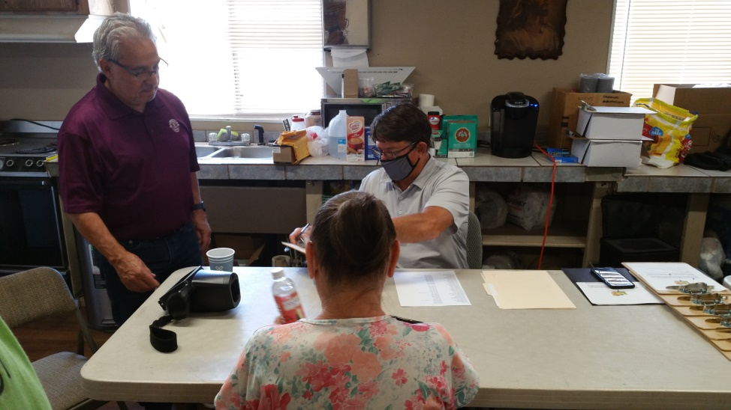
Typical Event Activities
Interviewing a client for the Mel Clack qualification form
Interviewing an entering client
Assisting a client in filling out the doctor’s examination form and recording preliminary refraction readings from the Spot Screener
Greeting a client at the Intake Table

Slide 7
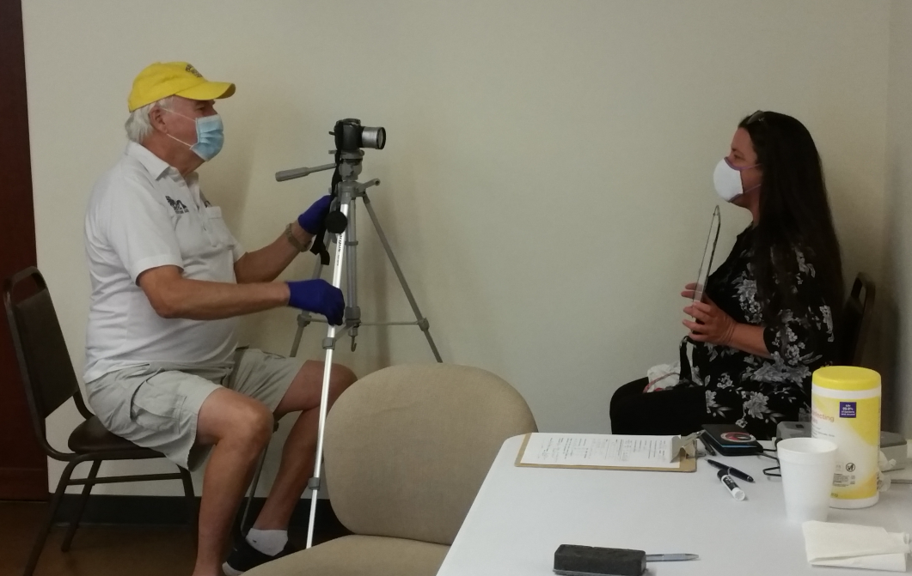
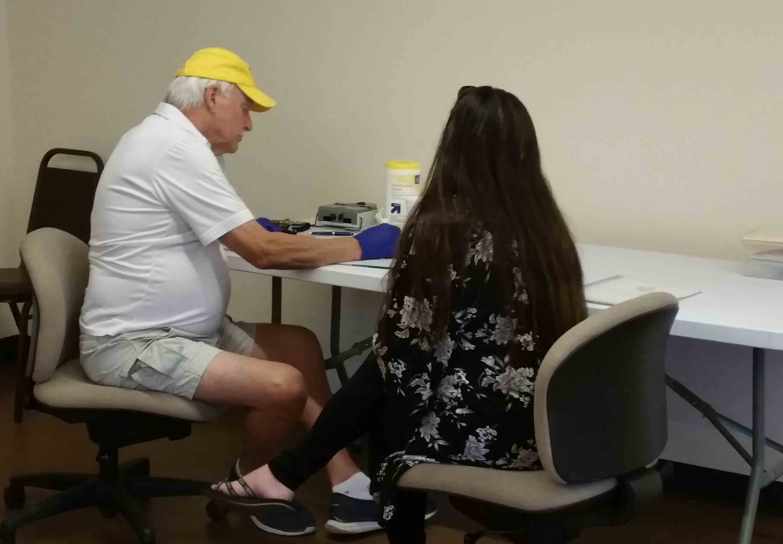
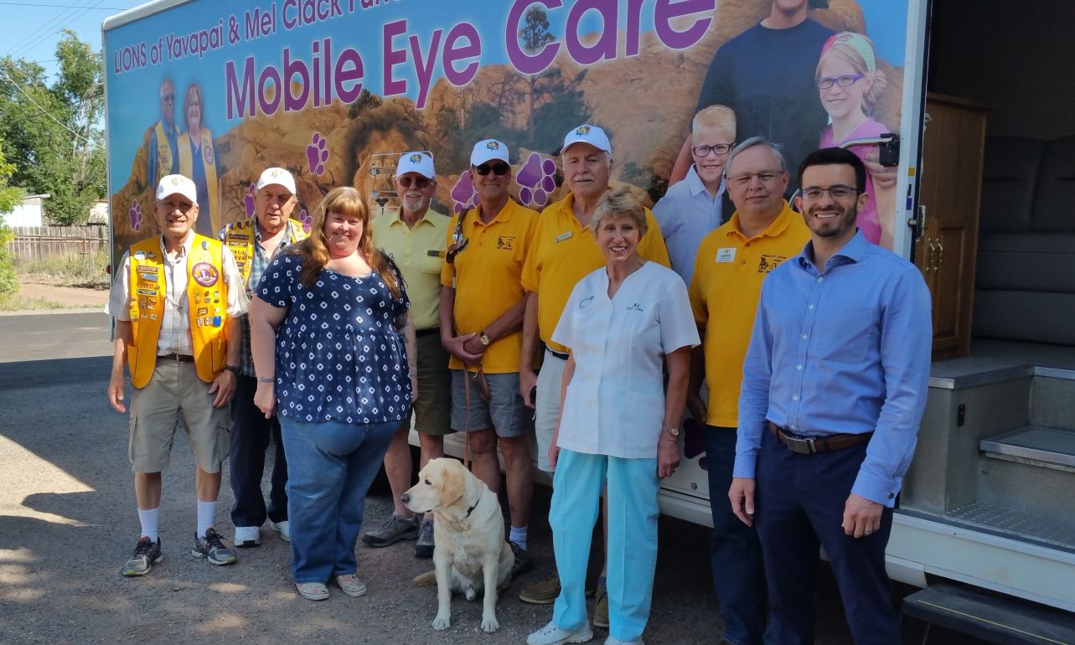
Taking client’s picture and assisting client in the selection of eye glass frames
Lions and with the doctor, optical tech and library coordinator after an event

